Slide 1

MACE Excellence Awards
Masterclass 3: Skills
Facilitator: Dr Amanda Hamilton-Attwell
2026

Slide 2


Preparing a winning entry

Slide 3

Your number 1 resource

Slide 4
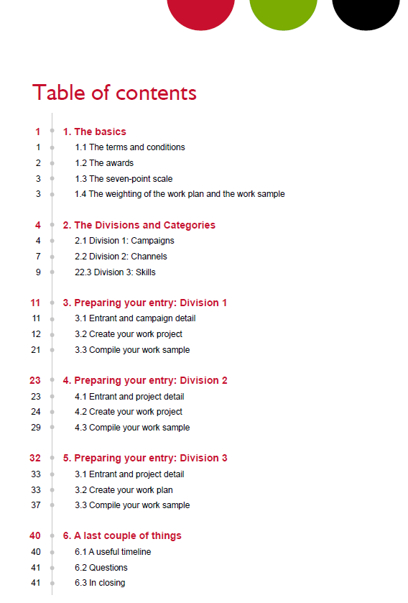
Everything you need to know!

Slide 5
Why should you submit an entry?
Be recognised for excellence
Get expert validation and feedback
Learn from and connect with peers
Strengthen your reputation and credibility
Motivate and inspire your team
Benchmark your work against the best
Improve future projects and programmes
Contribute to advancing the profession

Slide 6
Deadlines | Dates | Fees
Super Saver | 15 August 2026 | R900
Early Bird | 28 August 2026 | R1 000
Final | 4 September 2026 | R1 500

Slide 7





Awards
To win an award your entry must have achieved the following scores:
Bronze Award of Excellence: 5.24 to 5.74
Silver Award of Excellence: 5.75 or higher
Then there are special awards:
Gold Award of Excellence: The highest scoring Silver award winner in a category
Platinum Award of Excellence: The highest scoring Gold Award winning entry in every division
Chairperson’s Award of Excellence
MACE Award for Outstanding Research
The Severus Cerff Award for Consistent Excellence

Slide 8
The rules
You must be a member in good standing of MACE.
You must ensure that the PoP for the entries reach us by 4 September 2026.
The project must have been done between 1 March 2025 and 4 September 2026.
Most of the work (51%+) must have been done by you and not by an agency.
The “Permission to enter” letter must be signed by the appropriate person – Head of the Department.
Long-term campaigns may be entered, but the focus must be on the elements that were rolled out from 1 March 2025 to the day the entry is submitted in 2026.
Entries that have won in previous years may not be resubmitted, except if they were part of a multi-year campaign and new elements were added within the time frame.

Slide 9
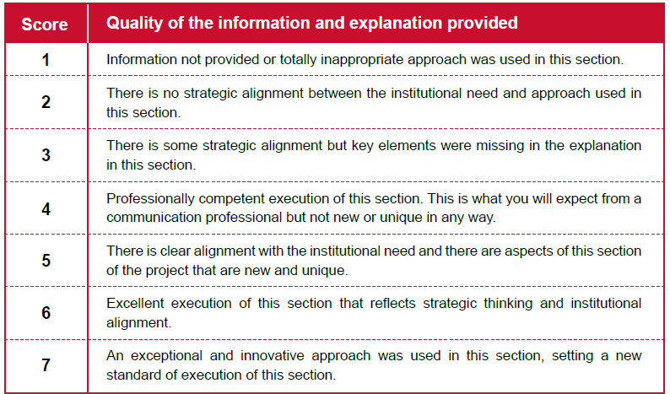
The seven-point scale of excellence

Slide 10
Disqualification
Our goal is to recognise excellence, not to disqualify entries. However, to ensure fairness for all entrants, entries may be disqualified if:
You did not use the entry form on the 2026 MACE Excellence Awards website.
They consist mainly of syndicated, reprinted, or stock material.
Work plans or supporting documentation exceed the prescribed length.
The project falls outside the specified eligibility period.
Submission requirements outlined in the Entry Guidelines have not been met.
A final review of your entry against the guidelines before submission can help avoid disappointment.

Slide 11
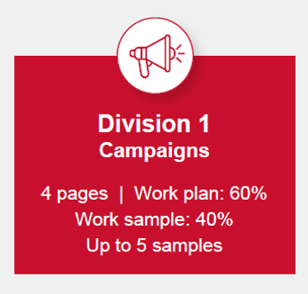
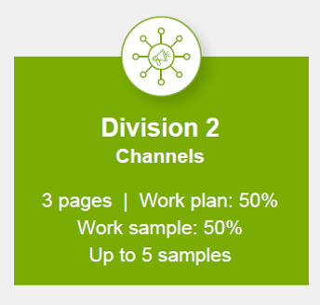
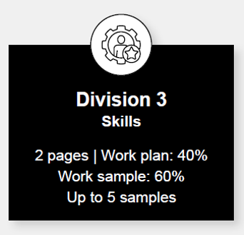
The weighting of the work plan and the work sample
The scoring of the different elements in the different divisions is the same, but the weighting of the work plan and the work sample differ:

Slide 12



Where to enter your project
8 categories
Campaigns typically include a range of communication platforms, be run over more than one day, and aim at one or more target groups.
12 categories
This division focuses on the media or channels you use to communicate your message to your target groups.
8 categories
This division recognises the specific skills used to achieve the communication objectives.

Slide 13
Read the division definitions carefully.
Choose the most appropriate category.
Important
Individual elements may be entered separately.
Remember
Notes:
📄 Read the division definitions carefully
Ensure that you understand the purpose and requirements of the division before selecting a category.
🎯 Choose the most appropriate category
Align your entry with the category that best reflects the primary objective, audience and outcomes of the project.
💬 Remember: individual elements may be entered separately
Components of a campaign—such as publications, videos, events, digital assets or research—may also qualify for entry in other divisions where appropriate.

Slide 14

Preparing a Skills entry
Use the entry form on the MACE website to provide the information for your work plan and work sample. If you do not use the entry form, your entry will be disqualified and not evaluated.

Slide 15

Important!
2 pages
Work plan: 40%
Work sample: 60%
Up to 5 samples
Categories
Design for printed channels
Design for visual channels
Design for digital channels
Writing for news channels
Writing for features, documentaries, and brochures
Writing scripts
Writing for the web
Photography: News, feature articles and documentaries
Videography

Slide 16
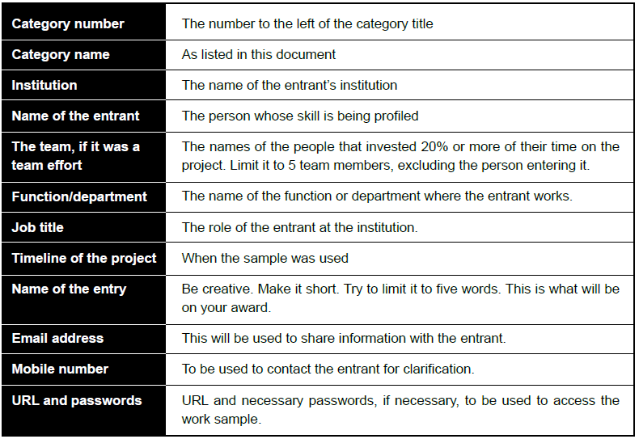
Entrant and project detail
Please provide the correct detail because this is what will be used on your award

Slide 17
Your work plan
Background
The need for the skill
The target audience
Goal and objective

Slide 18
1. Background To what extent did the entrant:
Explain the context for the product entered
Provide a realistic budget, including the number of people that worked on the project Indicated their role in the project and the percentage of work and the budget that was outsourced

Slide 19
The background
Provide | Provide background about the institution that will enable the evaluator to understand the context of this skill
Provide | Provide the budget and the roles of the project team that worked on delivering this skill.
Explain | Explain the process used to deliver the skills project.

Slide 20
2. The need for the project To what extent did the entrant:
1. Indicate the need for this product and how it was aligned to the strategy of the institution

Slide 21
The need for the project
Explain the institutional need that triggered the project of which this skill was part of.
A problem | Something was wrong.
Tip
Clearly describe:
The situation before the project
Why it mattered
The consequences of doing nothing
A need | Something was missing.
An opportunity | A favourable situation existed that could be leveraged.

Slide 22
The need for the project
Indicate how formal or informal research was used to define the need
Evaluators want to know
How do you know this problem, need or opportunity existed?
You need research
Formal research examples
Informal research examples
Tip
Whenever possible, include:
Numbers, statistics, survey findings, research insights, stakeholder feedback

Slide 23
3. Target audience To what extent did the entrant:
1. Indicate the audience this product was aimed at
Provide information about the audience's characteristics and how this product took account of that

Slide 24
Differentiate your audiences based according to primary, secondary and tertiary.
The target audience/s
Use research not more than two years old to define audience characteristics relevant to this skill.

Slide 25
4. Goal and objective To what extent did the entrant:
1. Indicate what the product set out to achieve
Measure if the objectives were achieved

Slide 26
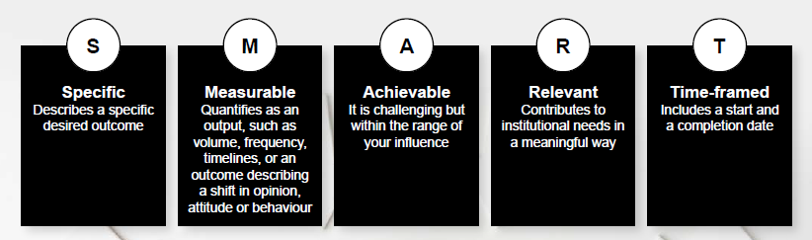
Goal and objectives
The Achilles heel of many entries

Slide 27
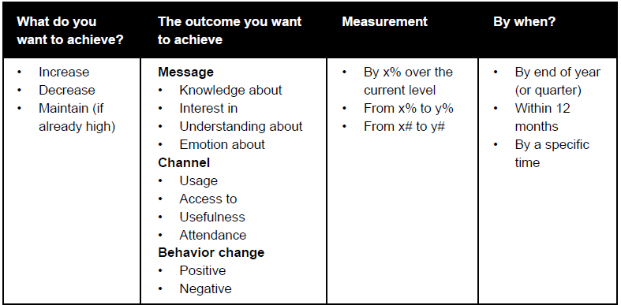
The following framework can help you formulate your objectives

Slide 28
Goal and objectives
Before evaluating a project's success, evaluators need to understand what the project was designed to achieve.
A strong entry demonstrates a clear line of sight from:
Need → Goal → Objectives → Results
If the objectives are unclear, unrealistic, or not measurable, evaluators cannot determine whether the project was successful.
What evaluators are looking for

Slide 29
Goal and objectives
Criterion 1: Provide a realistic overarching goal
What is a goal?
A goal is the broad, long-term change the project seeks to achieve.
A goal should describe the desired future state rather than the activities undertaken.
Strong goals
To improve employee understanding of the organisation's strategic direction.
To strengthen the institution's reputation among prospective students.
Tip
A goal should answer the question:
"What difference are we trying to make?"

Slide 30
Goal and objectives (continued)
Criterion 2: Provide output and outcome objectives
What is an output objective?
Output objectives measure what the project produced.
These are usually under the direct control of the communication team.
Output objectives measure activity.
They tell evaluators what was done.
What is an outcome objective?
Outcome objectives measure the effect of the project on the audience.
Outcome objectives measure change.
They tell evaluators what happened because of the project.
Examples
The video must be viewed 20,000 times in a week.
The news report must be downloaded 10,000 times during the first 12 months.
The photograph must be clicked on 2,000 within a week.
Examples
Audience awareness of the programme to increase from 10% to 50%.
Employee understanding of the institution’s goals to increase from 25% to 65%.
Positive perception of the institution to improve from 30% to 50%.
65% of administrative staff actively practice the customer experience standards daily.
Enrolment to increase by 10% and market share by 2%.
Advertising value equivalency (AVE) is not a valid impact measurement. Outcome measurements must always support it.
Remember

Slide 31
Goal and objectives (continued)
Criterion 3: State objectives in SMART terms
Specific
Measurable
Achievable
Relevant
Time-bound
SMART means
Weak objective | Better objective | Strong SMART objective
Increase awareness. What awareness? By how much? Among whom? By when? | Increase awareness of the new student support programme among first-year students. Still not measurable. | Increase awareness of the new student support programme among first-year students from 40% to 70% by the end of the first semester.
Specific
Measurable
Achievable
Relevant
Time-bound
Now the objective is

Slide 32
A simple formula to use when you create your objectives
Increase / Decrease / Maintain… | What? Among whom? From what baseline? To what target? By when?
Example | Increase employee understanding of the company's strategy among permanent employees from 58% to 75% by December 2026.
Notes:
The Golden Rule
Every objective should allow evaluators to answer one question:
"How will we know whether success was achieved?"
If success cannot be measured, the objective is not SMART.
If the objective describes an activity, it is not an objective.
If the objective cannot be linked to the need identified earlier, it is unlikely to score well.
The strongest entries demonstrate a clear connection between the need, the goal, the objectives, and the final results.
One thing I would add in the workshop, because it is often a revelation to entrants:
Objectives are not activities.
"Launch a website", "Hold an event", "Produce a video", "Distribute a newsletter" and "Run a social media campaign" are activities or tactics.
Objectives describe the change those activities are intended to create.
When evaluators see that distinction, the quality of scoring becomes much more consistent, and when entrants understand it, their scores usually increase dramatically.

Slide 33
Your work sample
Alignment with the objectives, the target audience's characteristics and the institutional needs
The creative approach
Professional execution

Slide 34
8. Alignment with the objectives and the target audience’s characteristics and needs To what extent was:
1. The application of this skill appropriate to the audience and the objectives
Will it achieve the objectives set? Will it resonate intellectually and emotionally with the target groups?

Slide 35
Alignment with the objectives and the target audience’s characteristics and needs
Avoid
Your work sample should:
Bring your work plan to life
  Demonstrate how your strategy, messages and tactics were implemented.
Tell the story of your project
  Present the work sample as a logical journey, showing how the project unfolded from start to finish.
Demonstrate strategic alignment
  Show how the messages, channels and creative execution reflect the objectives, audience insights and strategic approach described in the work plan.
Illustrate audience-centred communication
  Make it clear how the project was designed to engage the target audience intellectually and emotionally.
Show creativity and innovation
  Include examples that demonstrate original thinking and effective execution, not simply attractive design.
Repeating information already included in the work plan.
Including unnecessary reports or supporting documents.
Providing SurveyMonkey graphs or raw data that are not discussed.
Submitting files that are difficult to access or review.
Including videos longer than three minutes.
The evaluator should never have to search for evidence.
If your work plan says:
you developed three key messages,
segmented four audiences,
used storytelling,
adopted a digital-first approach,
and created an emotional connection,
then your work sample should make each of those points immediately visible
NB!
Notes:
The Work Sample is your evidence. It is where you prove that the campaign described in your Work Plan came to life.
The evaluator should never have to search for evidence.
In other words, the work sample should validate every important claim made in the Work Plan.
I would even give them this simple formula:
The Work Plan makes the promise.
The Work Sample proves the promise.
That single sentence captures the relationship between the two documents and, I think, would become one of the key takeaways from your workshop. It also mirrors how experienced evaluators—including yourself—naturally assess entries: first they understand the plan, then they look for evidence that it was executed consistently and effectively.

Slide 36
Alignment with the objectives and the target audience’s characteristics and needs (continued)
Appropriateness of the visual design
Appropriateness of the writing style
Alignment with the objectives
Alignment with the target audience
You should ensure
If I removed the work plan and showed only this asset to the evaluator, would they immediately recognise who it was designed for, what it was trying to achieve, and why it would appeal to that audience?
The Golden Rule
Objectives → Audience → Messages → Creative Execution
Notes:
Evaluators are not evaluating the design. They are evaluating the appropriateness of the design.
That's a subtle but very important distinction.
They're asking:
"Is this the right design, language and approach for this audience and these objectives?”
This section assesses whether the campaign was designed for the audience it was intended to reach.
Outstanding creative work is not enough.
The design, language, messages and overall approach must all support the objectives and resonate with the target audience.
The question evaluators ask is:
"Would this campaign effectively engage this audience and help achieve the stated objectives?”
Criterion 1: Appropriate Visual Design
Visual design should support communication—not compete with it.
Evaluators consider whether:
The design reflects the organisation's brand.
Images, colours and typography are appropriate for the audience.
The layout is engaging and easy to navigate.
The design reinforces the campaign objectives.
Visual elements attract attention without distracting from the message.
Remember:
Good design is purposeful design.
Criterion 2: Appropriate Writing Style
The content should sound as though it was written for the intended audience.
Evaluators look for:
Appropriate tone of voice.
Language the audience will understand.
Clear and concise writing.
Consistent messaging.
Calls to action that motivate the audience.
Criterion 3: Alignment with the Objectives
Every communication asset should support the SMART objectives presented in the Work Plan.
Ask yourself:
Does this brochure, video, webpage or social media post help achieve one or more of the stated objectives?
If the answer is unclear, the evaluator will question whether the asset belongs in the campaign.
Every asset should have a clear purpose.
Criterion 4: Alignment with the Target Audience
Outstanding campaigns demonstrate a deep understanding of the audience.
Evaluators look for evidence that the campaign reflects:
Audience needs.
Audience interests.
Audience motivations.
Audience preferences.
Audience behaviours.
Cultural and contextual considerations.
Nothing in the campaign should feel generic.
The audience should immediately feel that the campaign was created specifically for them.

Slide 37
9. Creative approach To what extent was:
1. The application of the skill really "wow"!
The application original, while matching the characteristics of the target audience It evident that smart thinking went into the way the audience’s perspective and needs were addressed The approach, design, visual elements, or medium applied in a new and surprising way

Slide 38
Creative approach
Creativity without a strategy is art.
Strategy without creativity is dead.
Is the idea fresh?
  The best ideas often seem obvious once you see them. We are looking for ideas that are fresh, clever and well suited to the challenge, not ideas that are strange or different simply for the sake of being different.
Is your creative approach right for your target audience?
  Creativity should never come at the expense of effectiveness. A brilliant idea that doesn't appeal to your audience is simply a missed opportunity.
  The way you write, design and communicate should reflect the needs, interests and behaviours of the audience you described in your work plan.
Will people remember it?
  The most creative projects leave a lasting impression. Think about whether your project made people stop, think, feel something or take action. If it blended into everything else your audience sees every day, it probably wasn't creative enough.
As entrant you must ask yourself
Was the idea fresh and original?
Did the creative concept strengthen the communication objective?
Was the creativity appropriate for the target audience?
Did it make the project more engaging and memorable?
Could another institution easily have produced exactly the same project, or was there something distinctive about it?
What the evaluators will be looking for

Slide 39
10. Professional execution To what extent did this entry reflect:
1. High-quality application of a specific skill
Superior thinking and strategic alignment Consistency between the work plan (what would be delivered) and the work sample Evidence of care and attention being devoted to preparing the entry

Slide 40
Professional execution
High-quality skills application.
Inspirational, superior thinking and strategic alignment with the institutional need.
Evidence of care and attention being devoted to preparing the entry.
Respect for the evaluator’s time.

Slide 41
Professional execution
Evaluators look for
High-quality skills application
  Your entry should be clear, concise and professionally written. Grammar, spelling, layout, design and the quality of your work samples all contribute to the evaluator's confidence in your work.
Inspirational thinking and strategic alignment
  Outstanding projects don't just look good, they solve an institutional challenge. Evaluators want to see evidence of strategic thinking and a project that clearly supports your institution's goals.
Excellent project management
  A great idea is only valuable if it is well executed. Evaluators will look for evidence that the project was carefully planned, implemented and managed, with appropriate resources, timelines and monitoring.
Consistency between the work plan and the work sample
  This is one of the biggest reasons entries lose marks.
Care and attention devoted to preparing the entry
  Your entry itself reflects your professionalism. Evaluators notice when an entry is well organised, information is easy to find, links work correctly, work samples are clearly labelled and references are concise.
Remember
The evaluator may assess many entries over several days. A well-prepared entry respects the evaluator's time and allows your excellent work to shine.
Notes:
This is the final section of the evaluation. By this stage, the evaluator has read your work plan, reviewed your work sample and assessed every section individually. Now they step back and ask one final question: "Does this entry demonstrate professional excellence?"
Professional execution is about much more than good writing or attractive design. It is about demonstrating that every aspect of the project, and every aspect of your entry, reflects a high standard of professionalism.

Slide 42

In conclusion
This session dealt with all the aspects in detail, on how a Skill entry must be compiled.
?
Do you have any questions?

Slide 43
MACE Excellence Awards
Dr Amanda Hamilton-Attwell
083 654 0565
amanda@businessdna.co.za

