Slide 1

MACE Excellence Awards
Masterclass 1: Campaigns
Facilitator: Dr Amanda Hamilton-Attwell
2026

Slide 2


Preparing a winning entry

Slide 3

Your number 1 resource

Slide 4
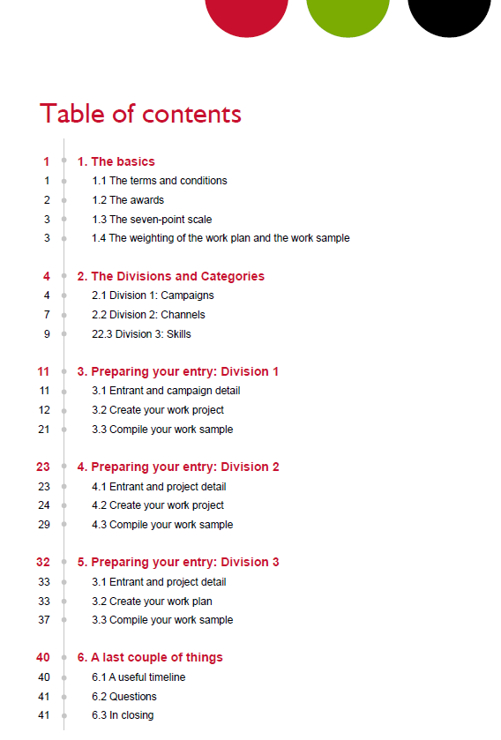
Everything you need to know!

Slide 5
Why should you submit an entry?
Be recognised for excellence
Get expert validation and feedback
Learn from and connect with peers
Strengthen your reputation and credibility
Motivate and inspire your team
Benchmark your work against the best
Improve future projects and programmes
Contribute to advancing the profession

Slide 6
Deadlines | Dates | Fees
Super Saver | 15 August 2026 | R900
Early Bird | 28 August 2026 | R1 000
Final | 4 September 2026 | R1 500

Slide 7





Awards
To win an award your entry must have achieved the following scores:
Bronze Award of Excellence: 5.24 to 5.74.
Silver Award of Excellence: 5.75 or higher
Then there are special awards:
Gold Award of Excellence: The highest scoring Silver award winner in a category
Platinum Award of Excellence: The highest scoring Gold Award winning entry in every division
Chairperson’s Award of Excellence
MACE Award for Outstanding Research
The Severus Cerff Award for Consistent Excellence

Slide 8
The rules
You must be a member in good standing of MACE.
You must ensure that the PoP for the entries reach us by 4 September 2026.
The project must have been done between 1 March 2025 and 4 September 2026.
Most of the work (51%+) must have been done by you and not by an agency.
The “Permission to enter” letter must be signed by the appropriate person – Head of the Department.
Long-term campaigns may be entered, but the focus must be on the elements that were rolled out from 1 March 2025 to the day the entry is submitted in 2026.
Entries that have won in previous years may not be resubmitted, except if they were part of a multi-year campaign and new elements were added within the time frame.

Slide 9
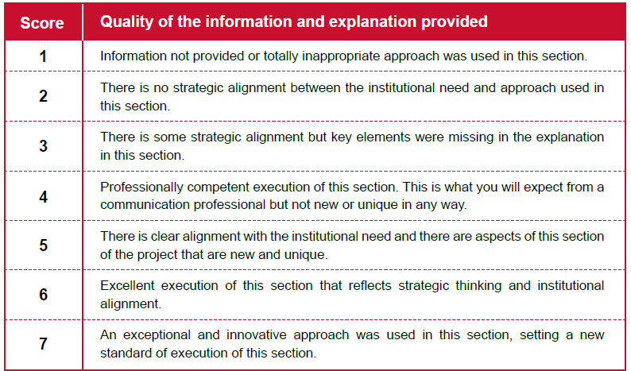
The seven-point scale of excellence

Slide 10
Disqualification
Our goal is to recognise excellence, not to disqualify entries. However, to ensure fairness for all entrants, entries may be disqualified if:
You did not use the entry form on the 2026 MACE Excellence Awards website.
They consist mainly of syndicated, reprinted, or stock material.
Work plans or supporting documentation exceed the prescribed length.
The project falls outside the specified eligibility period.
Submission requirements outlined in the Entry Guidelines have not been met.
A final review of your entry against the guidelines before submission can help avoid disappointment.

Slide 11
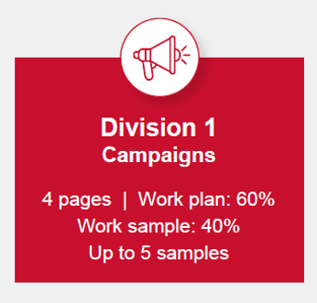
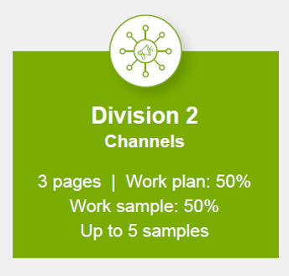
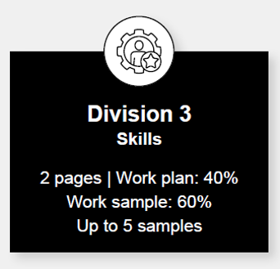
The weighting of the work plan and the work sample
The scoring of the different elements in the different divisions is the same, but the weighting of the work plan and the work sample differ:

Slide 12



Where to enter your project
8 categories
Campaigns typically include a range of communication platforms, be run over more than one day, and aim at one or more target groups.
12 categories
This division focuses on the media or channels you use to communicate your message to your target groups
8 categories
This division recognises the specific skills used to achieve the communication objectives.

Slide 13
Read the division definitions carefully.
Choose the most appropriate category.
Important
Individual elements may be entered separately.
Remember

Slide 14

Preparing a Campaign entry
Use the entry form on the MACE website to provide the information for your work plan and work sample. If you do not use the entry form, your entry will be disqualified and not evaluated.

Slide 15

Categories
Brand-building campaigns
Fundraising campaigns
Stakeholder engagement campaigns
Issue management campaigns
Crisis management campaigns
Student recruitment campaigns
Community and social-responsibility campaigns
Alumni campaigns
Important!
4 pages
Work plan: 60%
Work sample: 40%
Up to 5 samples

Slide 16
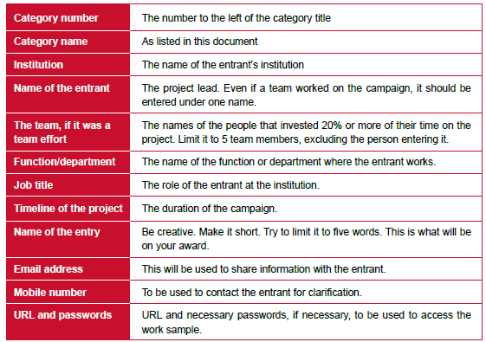
Entrant and campaign detail
Please provide the correct detail because this is what will be used on your award

Slide 17
Your work plan
Background
The need for the campaign
The target audience
Goal and objectives
The strategic approach
The campaign implementation
Measurement and evaluation

Slide 18
1. Background To what extent did the entrant:
Explain the organisation and the context for the entry.

Slide 19
The background
Tell | Tell your story!
Grab | Grab the attention of the evaluator
Provide | Provide information relevant to the project about the institution and the environment in which the institution functions
Imagine | Imagine that the evaluator is from Mars!

Slide 20
2. The need for the campaign To what extent did the entrant:
1. Link the strategy and needs of the institution with the marketing, advancement, or communication opportunity.
2. Explain how the project or intervention solved a problem, filled a need, or helped to leverage an opportunity.
3. Indicate how formal or informal research was used to define the need.

Slide 21
The need for the campaign
Help them by answering three questions:
Why did the organisation need this project?
What problem, need or opportunity did it address?
How do you know that problem, need or opportunity actually existed?
What evaluators are looking for:
Link the strategy and needs of the institution with the marketing, advancement or communication opportunity
Always connect the project to:
Strategic goals
Business objectives
Institutional priorities
Stakeholder needs
What you need to do:
Tip

Slide 22
The need for the campaign (continued)
Explain how the project solved a problem, filled a need or leveraged an opportunity.
A problem | Something was wrong.
Tip
Clearly describe:
The situation before the project
Why it mattered
The consequences of doing nothing
A need | Something was missing.
An opportunity | A favourable situation existed that could be leveraged.

Slide 23
The need for the campaign (continued)
Indicate how formal or informal research was used to define the need.
Evaluators want to know
How do you know this problem, need or opportunity existed?
You need research
Formal research examples
Informal research examples
Tip
Whenever possible, include:
Numbers, statistics, survey findings, research insights, stakeholder feedback
“The university's strategic plan identified student recruitment as a priority. Enrolment applications had declined by 12% over three years. Research among prospective students revealed low awareness of key programmes. The recruitment campaign was developed to address this gap and support institutional growth objectives.”

Slide 24
3. Target audience To what extent did the entrant:
1. Provide detail about the audience characteristics and needs.
Provide information that showed how the target audience was linked to the business and communication strategies. Indicate how formal or informal research was used to define the need.

Slide 25
Your target audience/s
Identify your primary and secondary audiences
Describe the audience’s demographics and characteristics
Explain the audience’ needs, perceptions and behaviours relevant to the campaign
Demonstrate that you understand the audiences based on insights through research
Show how messages were tailored to the audience
Explain why specific channels were selected
A well-structured description
"The primary audience was first-year undergraduate students aged 18–24. Research revealed that many felt overwhelmed during the transition to university and relied heavily on mobile devices and peer recommendations for information. These insights informed the campaign's mobile-first approach and emphasis on peer storytelling."

Slide 26
4. Goal and objective To what extent did the entrant:
1. Provide a realistic over-arching goal to be achieved by the campaign.
Provide output and outcome objectives supporting the goal and related to the need for the project. Stated the objectives in SMART terms.

Slide 27
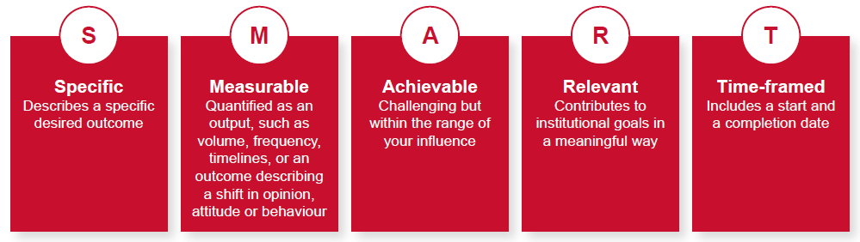
Goal and objectives
The Achilles heel of many entries

Slide 28
Goal and objectives
Before evaluating a project's success, evaluators need to understand what the project was designed to achieve.
A strong entry demonstrates a clear line of sight from:
Need → Goal → Objectives → Results
If the objectives are unclear, unrealistic, or not measurable, evaluators cannot determine whether the project was successful.
What evaluators are looking for

Slide 29
Goal and objectives
Criterion 1: Provide a realistic overarching goal
What is a goal?
A goal is the broad, long-term change the project seeks to achieve.
A goal should describe the desired future state rather than the activities undertaken.
Strong goals
To improve employee understanding of the organisation's strategic direction.
To strengthen the institution's reputation among prospective students.
Tip
A goal should answer the question:
"What difference are we trying to make?"

Slide 30
Goal and objectives (continued)
Criterion 2: Provide output and outcome objectives
What is an output objective?
Output objectives measure what the project produced.
These are usually under the direct control of the communication team.
Output objectives measure activity.
They tell evaluators what was done.
What is an outcome objective?
Outcome objectives measure the effect of the project on the audience.
Outcome objectives measure change.
They tell evaluators what happened because of the project.
Examples
Increase employee understanding of the strategy from 55% to 75%.
Improve stakeholder trust by 15%.
Increase applications from target schools by 10%.
Increase alumni participation from 20% to 35%.
Examples
Conduct 20 stakeholder engagement sessions.
Distribute information to 5,000 employees.

Slide 31
Goal and objectives (continued)
Criterion 3: State objectives in SMART terms
Specific
Measurable
Achievable
Relevant
Time-bound
SMART means
Weak objective | Better objective | Strong SMART objective
Increase awareness. What awareness? By how much? Among whom? By when? | Increase awareness of the new student support programme among first-year students. Still not measurable. | Increase awareness of the new student support programme among first-year students from 40% to 70% by the end of the first semester.
Specific
Measurable
Achievable
Relevant
Time-bound
Now the objective is

Slide 32
A simple formula to use when you create your objectives
Increase / Decrease / Maintain… | What? Among whom? From what baseline? To what target? By when?
Example | Increase employee understanding of the company's strategy among permanent employees from 58% to 75% by December 2026.

Slide 33
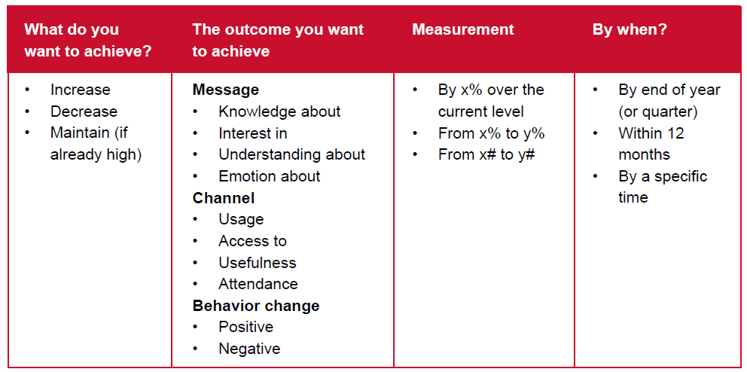

Slide 34
5. The strategic approach To what extent did the entrant:
1. Provide and explain the primary and supporting messages.
Provide the rationale used for linking the target audience(s) and objectives to tactics and the roll-out plan. Indicate the link to the institution’s needs. Use an innovative approach that will resonate intellectually and emotionally with the target audience.

Slide 35
The strategy
Why specific messages were chosen.
Why particular audiences were targeted.
Why certain tactics and channels were selected.
How the approach supports institutional goals.
What made the campaign distinctive, engaging or innovative.
Evaluators want to know
A strong strategic approach demonstrates that every element of the campaign was deliberately designed to achieve the stated objectives.

Slide 36
The strategy (continued)
Criterion 1: Primary and supporting messages
What are primary messages?
  Primary messages are the most important ideas the audience must remember.
What are supporting messages?
  Supporting messages reinforce the primary message and provide additional information, evidence or motivation.
Example:
Primary message:
  "Every employee plays a role in delivering an exceptional student experience."
Supporting message:
  Student satisfaction affects institutional success.
What evaluators want
What the key and supporting messages were.
Why they were selected.
How they support the objectives.

Slide 37
The strategy (continued)
Criterion 2: Linking audiences and objectives to tactics
Example:
Research showed that prospective students relied heavily on social media and peer recommendations when selecting a university. Social media storytelling and student ambassador videos were therefore selected as the primary tactics to increase awareness and consideration among this audience.
This is often where entries lose marks.
Explain why each tactic was chosen.
It should relate to the explanation of the target audiences.
What evaluators want
Demonstrate that
Audience Insights → Objectives → Tactics
are clearly connected.

Slide 38
The strategy (continued)
Criterion 3: Innovation and audience resonance
Example:
Instead of promoting scholarships through fact sheets, the institution shared personal stories of scholarship recipients whose lives had been transformed through education.
The facts informed the audience.
The stories inspired the audience.
The campaign will appeal to both the head and the heart.
Innovation does not necessarily mean using new technology.
It means finding a fresh, relevant and engaging way to connect with the audience.
An approach that appeals:
Intellectually: The audience understands the message.
Emotionally: The audience cares about the message.
What evaluators want

Slide 39
The strategy (continued)
Criterion 4: Link to institutional needs
Example:
Institutional need: Increase enrolment in engineering programmes.
Strategic approach: Position engineering graduates as innovators who solve real-world challenges through a storytelling campaign featuring alumni success stories.
Every strategic decision should support the need identified earlier.
Indicate how will this approach help solve the problem, address the need or leverage the opportunity?
What messages were used.
Why those messages mattered.
Why specific tactics were selected.
How the approach addressed the organisational need.
Why the audience would find the campaign meaningful and compelling.
The strongest entries explain:

Slide 40
6. The project implementation To what extent did the entrant:
1. Provide a budget that is reasonable, given the institution and the scope of the intervention.
Make good use of the resources, including the budget. Provide a roll-out plan, indicating deadlines, challenges and solutions. Indicate their role in the campaign, and if applicable, what and why some aspects were outsourced.

Slide 41
Project implementation
Provide a realistic budget
  Give and Ensure the budget is appropriate for the size, scope and objectives of the project.
Demonstrate effective use of resources
  Show how financial, human and organisational resources were used efficiently to maximise impact.
Provide a detailed roll-out plan
  Include key phases, milestones, deadlines, responsibilities, anticipated challenges and contingency plans.
Clearly define your role
  Explain your responsibilities in planning and implementing the project, and identify any outsourced activities with the reasons for outsourcing.
Manage internal and external resources
  Demonstrate how internal teams, partners and service providers collaborated to deliver the project successfully.
Anticipate risks and challenges
  Identify implementation risks, explain how they were managed and describe any adjustments made during the project.

Slide 42
7. Measurement and evaluation To what extent did the entrant:
1. Measure the impact of the intervention against the original objectives set.
Explain the methodology (formal and informal) used to measure impact. Use a valid and reliable process to measure impact. Indicate how the results demonstrate that the campaign results contributed to achieving the institutional goals.

Slide 43
Measurement and evaluation
Measure every SMART objective
  Evaluate every objective against the targets established during the planning stage.
Measure outputs, outcomes and impact
  Demonstrate not only what was delivered, but also what changed because of the project.
Explain your measurement methodology
  Describe the formal and informal methods used to collect valid and reliable evidence.
Use credible and reliable data
  Support conclusions with accurate, objective and verifiable evidence.
Demonstrate organisational value
  Show how the results contributed to achieving the institution's strategic goals.
Evaluate, learn and improve
  Explain how the findings informed future planning and continuous improvement.

Slide 44
Measurement and evaluation
Section 4 (Objective) | Section 7 (Measurement)
Increase awareness from 35% to 60% | Awareness increased to 64%
Improve engagement from 52% to 70% | Engagement reached 71%
Increase applications by 10% | Applications increased by 12%
Measurement Pyramid
The evaluator's thought process
The evaluator asks four questions:
Question 1: Did they achieve what they said they would achieve?
Question 2: How do they know?
Question 3: Can I trust the evidence?
Question 4: Did it actually help the institution?
Excellent entries measure here
Impact
Outcomes
Outputs
Most entrants measure here
Activities

Slide 45
8. Alignment with the objectives and the target audience’s characteristics and needs To what extent was:
1. The visual elements and design appropriate.
Content written in a style suited to the target audience. The work samples aligned with the stated objectives. The approach of the campaign or project aligned to the profile of the target group.

Slide 46
Alignment with the objectives and the target audience’s characteristics and needs
Avoid
Your work sample should:
Bring your work plan to life
  Demonstrate how your strategy, messages and tactics were implemented.
Tell the story of your campaign
  Present the work sample as a logical journey, showing how the campaign unfolded from start to finish.
Demonstrate strategic alignment
  Show how the messages, channels and creative execution reflect the objectives, audience insights and strategic approach described in the work plan.
Illustrate audience-centred communication
  Make it clear how the campaign was designed to engage the target audience intellectually and emotionally.
Show creativity and innovation
  Include examples that demonstrate original thinking and effective execution, not simply attractive design.
Repeating information already included in the work plan.
Including unnecessary reports or supporting documents.
Providing SurveyMonkey graphs or raw data that are not discussed.
Submitting files that are difficult to access or review.
Including videos longer than three minutes.
The evaluator should never have to search for evidence.
If your work plan says:
you developed three key messages,
segmented four audiences,
used storytelling,
adopted a digital-first approach,
and created an emotional connection,
then your work sample should make each of those points immediately visible.
NB!

Slide 47
Alignment with the objectives and the target audience’s characteristics and needs (continued)
Appropriateness of the visual design
Appropriateness of the writing style
Alignment with the objectives
Alignment with the target audience
You should ensure
If I removed the work plan and showed only this asset to the evaluator, would they immediately recognise who it was designed for, what it was trying to achieve, and why it would appeal to that audience?
The Golden Rule
Objectives → Audience → Messages → Creative Execution

Slide 48
9. Creative approach To what extent was:
1. The entry really "wow"!
The approach original, while matching the characteristics of the target audience. It evident that smart thinking went into the way the audience’s perspective and needs were addressed. An approach, design, visual elements, or medium applied in a new and surprising way.

Slide 49
Creativity of the campaign assets
Creativity without a strategy is art.
Strategy without creativity is dead.
Is the idea fresh?
  The best ideas often seem obvious once you see them. We are looking for ideas that are fresh, clever and well suited to the challenge, not ideas that are strange or different simply for the sake of being different.
Is your creative approach right for your target audience?
  Creativity should never come at the expense of effectiveness. A brilliant idea that doesn't appeal to your audience is simply a missed opportunity.
  The way you write, design and communicate should reflect the needs, interests and behaviours of the audience you described in your work plan.
Will people remember it?
  The most creative campaigns leave a lasting impression. Think about whether your campaign made people stop, think, feel something or take action. If it blended into everything else your audience sees every day, it probably wasn't creative enough.
As entrant you must ask yourself
Was the idea fresh and original?
Did the creative concept strengthen the communication objective?
Was the creativity appropriate for the target audience?
Did it make the campaign more engaging and memorable?
Could another institution easily have produced exactly the same campaign, or was there something distinctive about it?
What the evaluators will be looking for

Slide 50
10. Professional execution To what extent did this entry reflect:
1. High-quality writing and superior production.
Inspirational, superior thinking and strategic alignment. Excellent project management principles through the execution of the project. Consistency between the work plan and the work sample. Evidence of care and attention being devoted to preparing the entry.

Slide 51
Professional execution
High-quality skills application.
Inspirational, superior thinking and strategic alignment with the institutional need.
Evidence of care and attention being devoted to preparing the entry.
Respect for the evaluator’s time.

Slide 52
Professional execution
Evaluators look for
High-quality writing and superior production
  Your entry should be clear, concise and professionally written. Grammar, spelling, layout, design and the quality of your work samples all contribute to the evaluator's confidence in your work.
Inspirational thinking and strategic alignment
  Outstanding projects don't just look good, they solve an institutional challenge. Evaluators want to see evidence of strategic thinking and a project that clearly supports your institution's goals.
Excellent project management
  A great idea is only valuable if it is well executed. Evaluators will look for evidence that the project was carefully planned, implemented and managed, with appropriate resources, timelines and monitoring.
Consistency between the work plan and the work sample
  This is one of the biggest reasons entries lose marks.
Care and attention devoted to preparing the entry
  Your entry itself reflects your professionalism. Evaluators notice when an entry is well organised, information is easy to find, links work correctly, work samples are clearly labelled and references are concise.
Remember
The evaluator may assess many entries over several days. A well-prepared entry respects the evaluator's time and allows your excellent work to shine.

Slide 53



In conclusion
This session dealt with all the aspects in detail, i.e. how a Campaign entry will be compiled.
In the next session, I shall focus more on preparing an entry in the Channel division.
The third session will deal with the Skills division.
?
Do you have any questions?

Slide 54
MACE Excellence Awards
Dr Amanda Hamilton-Attwell
083 654 0565
amanda@businessdna.co.za

